Slide 1

Data Cleaning & Normalization
Gene Expression Analysis
Tissue: Artery - Coronary

Slide 2
What is the Coronary Artery?
Coronary arteries are blood vessels that supply oxygen and nutrients directly to the heart muscle
They are essential for proper heart contraction and energy production
Blockage or dysfunction can lead to ischemia, atherosclerosis, or myocardial infarction
Studying gene expression in this tissue helps identify molecular mechanisms behind cardiovascular diseases

Slide 3
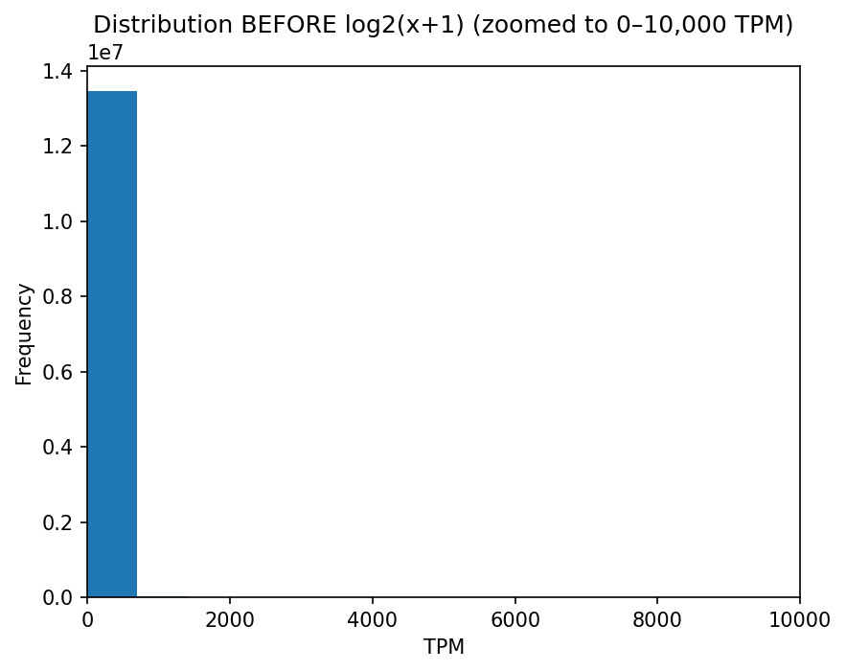
Distribution Before Log Transformation

Slide 4
Before Log Transformation - Interpretation
The distribution is highly skewed
Most genes have very low expression values
A small number of genes have extremely high expression
This imbalance makes statistical analysis difficult

Slide 5
Why Do We Apply Log2(x+1) Transformation?
Gene expression values span several orders of magnitude
Log transformation compresses extreme values
Reduces skewness and stabilizes variance
Makes expression differences between genes easier to compare
Prepares data for normalization and downstream analysis

Slide 6
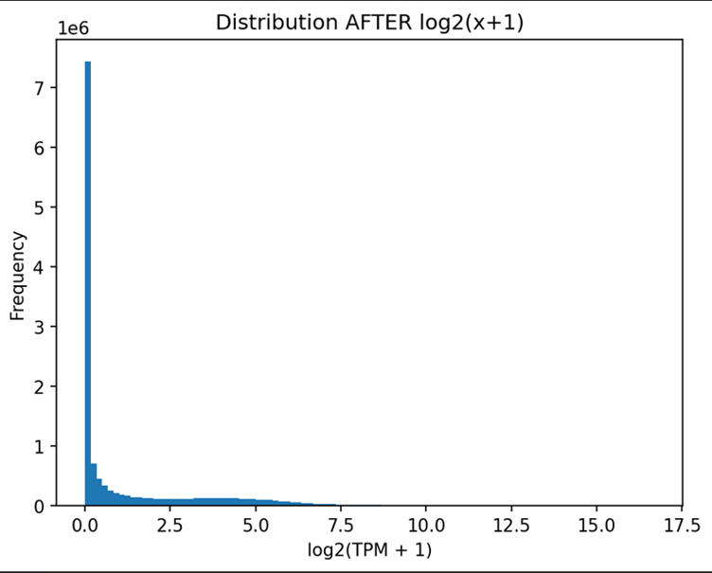
Distribution After Log2(x+1) Transformation

Slide 7
After Log Transformation - Interpretation
Expression values are compressed into a smaller range
Distribution becomes smoother and more balanced
Differences between low and medium expression genes are clearer
Data is now suitable for statistical analysis

Slide 8
Why Do We Perform Gene Filtering?
Gene expression datasets contain many genes with:
Very low expression across all samples
Little or no variance
Such genes represent technical noise. Including them can:
Mask meaningful patterns
Increase false discoveries

Slide 9
Gene Filtering - Explanation
Genes with very low expression or low variance were removed
Before filtering: 56,200 genes
After filtering: 17,309 genes
Removed genes contribute mostly noise
Filtering improves reliability of downstream analyses

Slide 10
Sample Filtering with Meta-Data
& Quantile Normalization
Bioinformatics Analysis Pipeline

Slide 11
Lab Overview
Objective: Data cleaning and normalization of gene expression samples
Apply quantile normalization to gene expression data
Filter samples by tissue type (Artery - Coronary)
Match samples with expression data
Filter by RNA quality (RIN > 6.0)

Slide 12
Step 1: RIN Statistics - Before Filtering
Summary Statistics
Count: 19,998 | Mean: 7.30 | Std: 1.06
Min: 3.1 | 25%: 6.5 | 50%: 7.2
75%: 8.0 | Max: 10.0
RIN Value Range
Range: 3.1 - 10.0
Wide variability indicates the need for quality filtering

Slide 13
Step 2: RIN Filtering (RIN ≥ 6)
Filtering Results
Before Filtering: 22,951 samples
After Filtering: 18,138 samples
Improved Statistics
Mean: 7.46 | Std: 0.99
Min: 6.0 | 25%: 6.7 | 50%: 7.3 | 75%: 8.1
✓ Improved RIN Range: 6.0 - 10.0 (Better quality distribution)

Slide 14
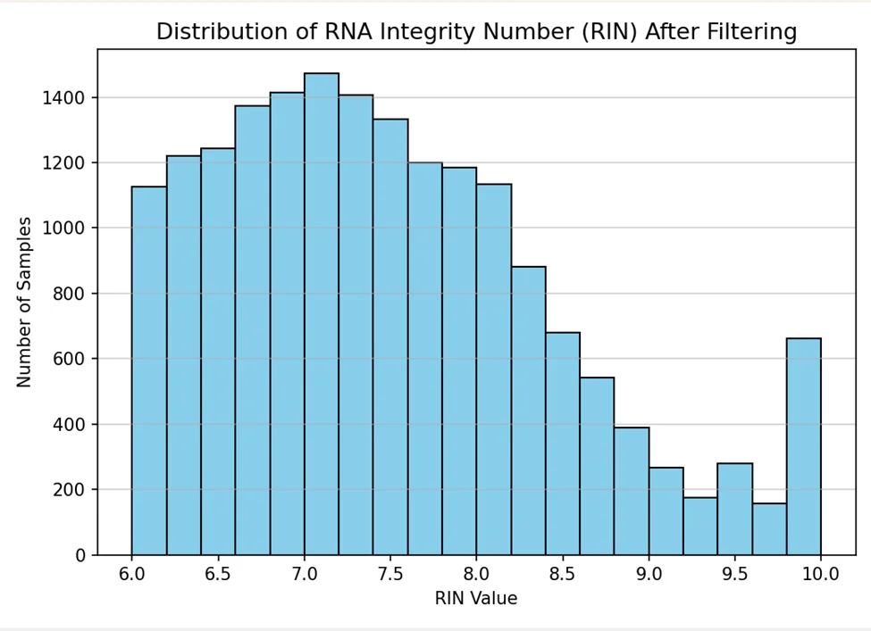
RIN Distribution After Filtering

Slide 15
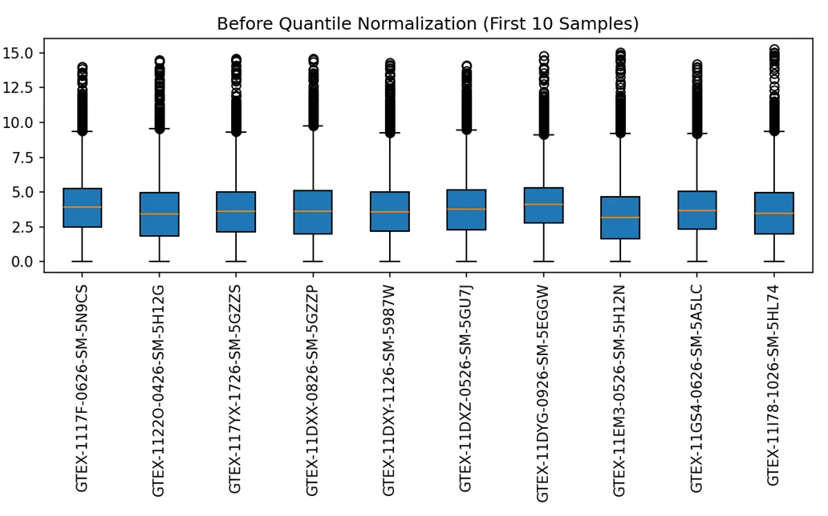
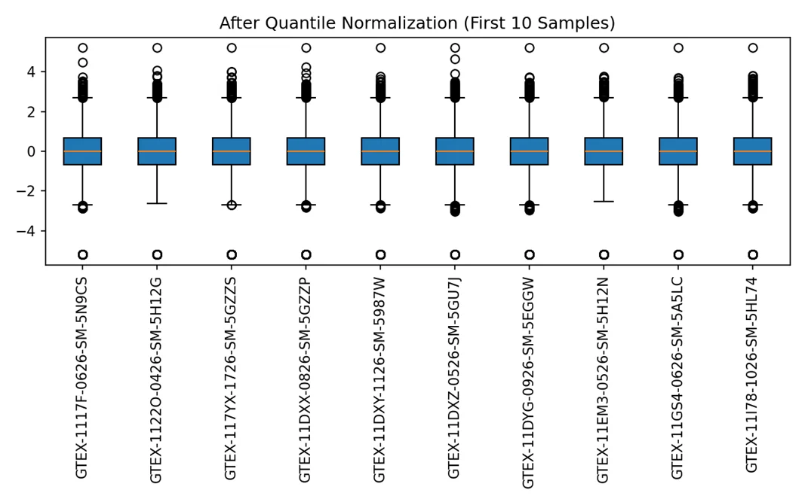
Quantile Normalization: Before & After

Slide 16
Step 3: Filter by Tissue Type
Keep only samples from: Artery - Coronary
# 3. Keep meta-data for chosen tissue (SMTSD)
tissue_name = "Artery - Coronary"
meta_tissue = meta[meta["SMTSD"] == tissue_name]
print("Meta-data for tissue", tissue_name, ":",
meta_tissue.shape[0], "samples")
Result: Meta-data for tissue Artery - Coronary: 253 samples

Slide 17
Step 4: Match with Expression Data
Keep only samples that have gene expression values
# 4. Keep samples with gene-expression values
expr_samples = set(expr_qn.columns)
meta_tissue_matched = meta_tissue[
meta_tissue["SAMPID"].isin(expr_samples)
]
print("Samples after matching:", meta_tissue_matched.shape[0])
Result: Samples after matching: 240

Slide 18
Step 5: Filter by RIN Quality (> 6.0)
Final filtering: keep only high-quality RNA samples
# 5. Filter samples with RIN > 6.0
meta_final = meta_tissue_matched[
meta_tissue_matched["SMRIN"] > 6.0]
print("Samples after filtering:", meta_final.shape[0])
meta_final.to_csv(out_dir / "meta_artery_coronary.csv")
Final Result: 213 high-quality samples

Slide 19
Pipeline Summary
Data Processing Steps
1. All tissues meta-data → 22,951
2. Artery - Coronary tissue → 253
3. Matched with expression → 240
4. After RIN > 6.0 filtering → 213
✓ Ready for downstream analysis with 213 samples

Slide 20
Linear Regression
Testing Gene Expression Associations
Tissue: Artery - Coronary

Slide 21
Lab Goal
Objective: Test whether gene expression levels are associated with technical and biological traits
For each selected gene, we will:
Plot scatter plots with linear regression lines
Calculate Pearson correlation (r) and p-values
Identify which traits have the strongest influence on gene expression

Slide 22
Traits to Test
Technical Variables
SMRIN - RNA quality
SMTSISCH - Ischemic time
SMNABTCH - NA batch
SMGEBTCH - Expression batch
Biological Variables
AGE - Age
SEX - Sex
DeathType - Death type

Slide 23
Step 1: Selecting Top 5 Genes by Correlation with SMRIN
Selection Method:
For each gene, we computed Pearson correlation (r) between expression and SMRIN
Sorted all genes by positive Pearson correlation r>0
Selected top 5 genes with strongest positive linear relationship to RNA quality
Strongest = largest positive r - meaning the clearest linear trend between gene expression and SMRIN

Slide 24
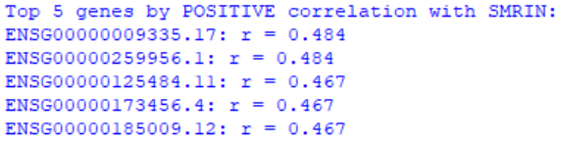
Top 5 Genes by Correlation with SMRIN

Slide 25
Step 2: Regression Analysis
Demonstration using one representative gene:
ENSG00000125484.11
We will examine the relationship between this gene's expression and all 7 traits
Each plot shows: scatter plot, regression line, correlation coefficient (r), and p-value

Slide 26
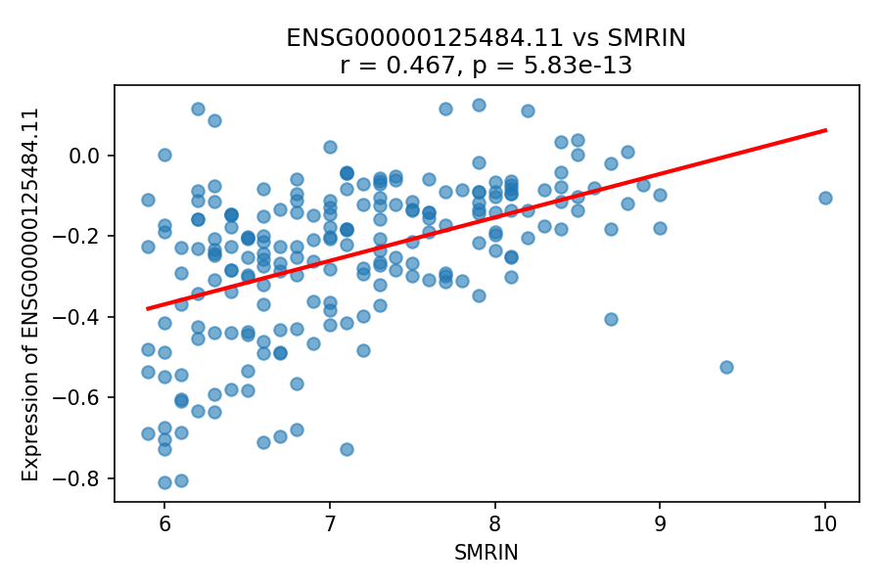
ENSG00000125484.11 vs SMRIN
r = 0.467 | p = 5.83e-13

Slide 27
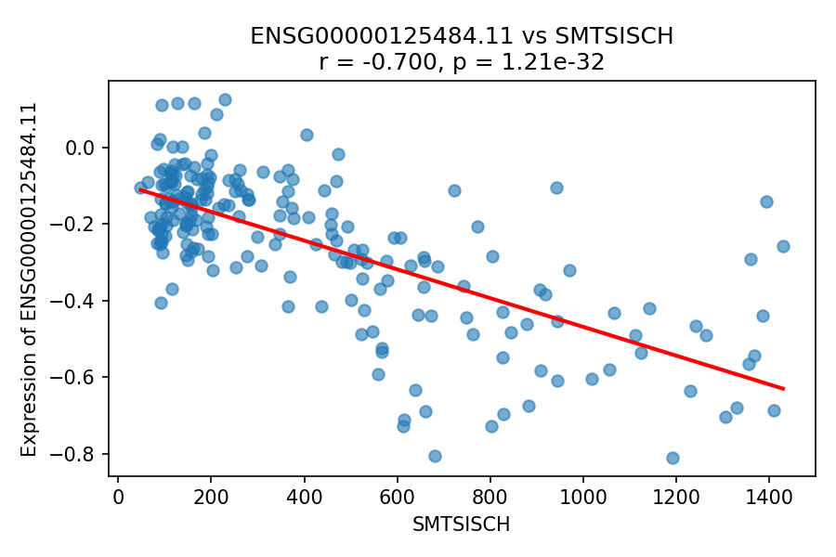
ENSG00000125484.11 vs SMTSISCH (Ischemic Time)

Slide 28
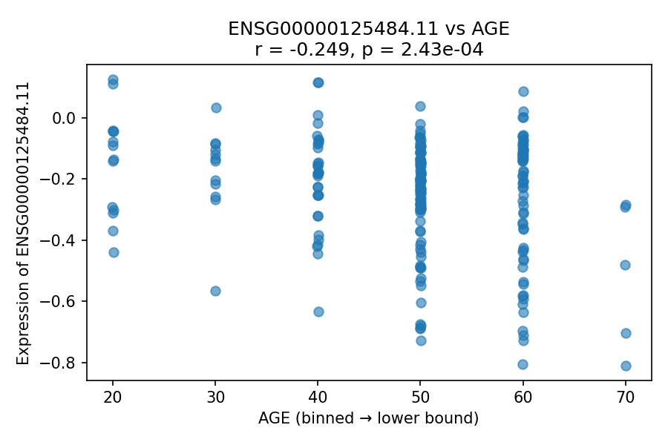
ENSG00000125484.11 vs AGE
Expression slightly increases with age bins, suggesting modest age-related effect. Effect is smaller than SMRIN or ischemic time (GTEx age is binned for privacy).

Slide 29
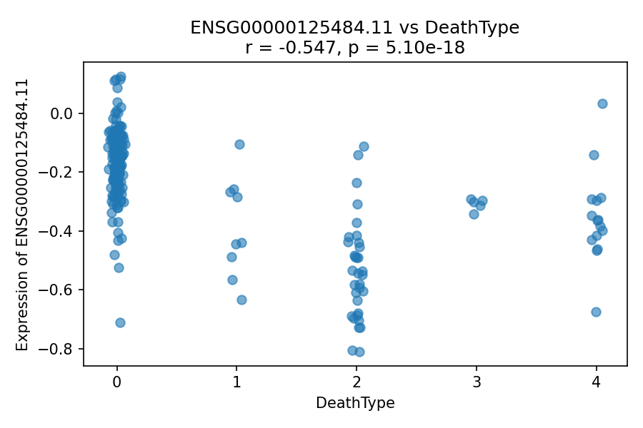
ENSG00000125484.11 vs DeathType (Hardy Scale)
Expression differs across death categories, indicating death circumstances can influence expression patterns. DTHHRDY is based on the Hardy scale classification system.

Slide 30
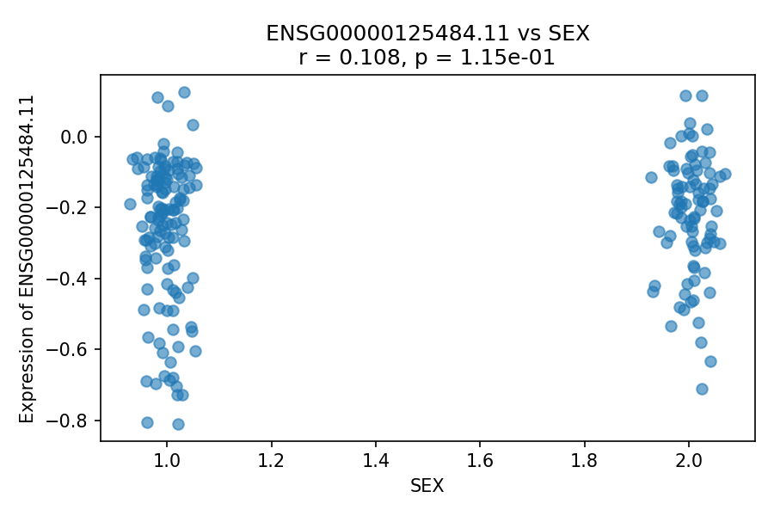
ENSG00000125484.11 vs SEX
Minimal difference between sexes with strong overlap between groups. Gene is likely regulated similarly in males and females in coronary artery tissue.

Slide 31
Principal Component Analysis (PCA)
Dimensionality Reduction
Tissue: Artery - Coronary

Slide 32
Goal of the Lab
Use PCA (Principal Component Analysis) to reduce high-dimensional gene expression data (thousands of genes) into a small number of components
PCA helps us visualize patterns, detect clusters/outliers, and check whether technical variables dominate the variation
Standard method for exploratory analysis of gene expression data

Slide 33
Step 1: Data Loading & Sample Matching
Key steps in the code:
Load expression matrix and metadata
Find intersection of sample IDs in both datasets
Reorder to ensure alignment
Why necessary: PCA results are only meaningful if each sample's expression profile is correctly paired with its metadata
Result: Expression (17,309 genes × 213 samples) | Metadata (213 samples × 62 traits)

Slide 34
Step 1 Result: After Alignment
Data Shapes
Expression: (17,309 genes × 213 samples)
Metadata: (213 samples × 62 traits)
Matrix for PCA
(213 samples × 17,309 genes)
PCA is performed on 213 Artery-Coronary samples

Slide 35
Step 2: PCA Computation
What PCA computes:
PC1 captures the largest variance direction across samples
PC2 captures the second largest variance direction (orthogonal to PC1)
Each sample gets a PC score (coordinates) on each PC
A PCA score matrix for plotting (samples × PCs) is produced and saved

Slide 36
Step 3: Explained Variance Ratio
PC1: 15.00% - Strongest global pattern
PC2: 10.36% - Second strongest independent pattern
PC3: 7.29%
PC4: 4.42%
PC5: 2.78%
Total variance explained by first 5 PCs: ~39.85%
First five PCs reduce thousands of genes into key axes

Slide 37
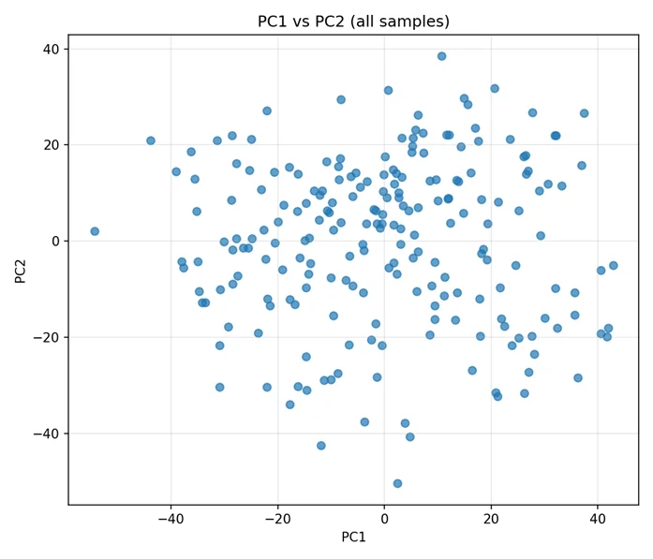
Step 4: PC1 vs PC2 Plot (All Samples)
Each dot is one Artery-Coronary sample positioned by PC1 (x-axis) and PC2 (y-axis) scores. Points form a broad cloud without clear separated clusters, suggesting variation is influenced by many subtle factors rather than one dominant variable.

Slide 38
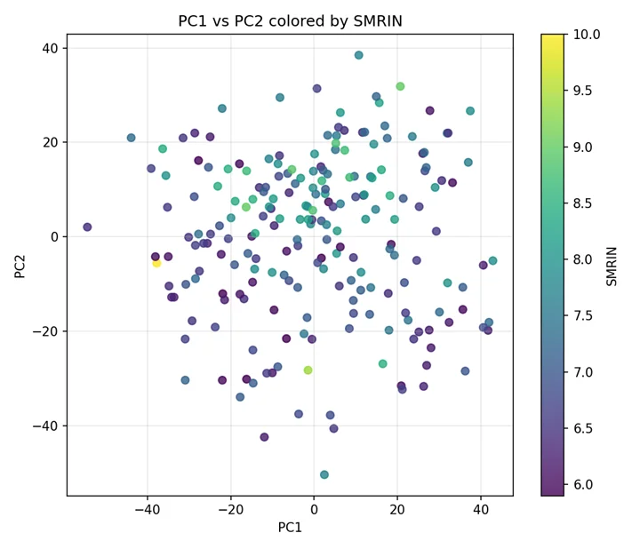
PC1 vs PC2 Colored by SMRIN
Colors are mixed across PCA space with no strong gradient or clear separation. SMRIN does not strongly drive PC1 or PC2 in this filtered dataset, meaning it's not the main source of variance.

Slide 39
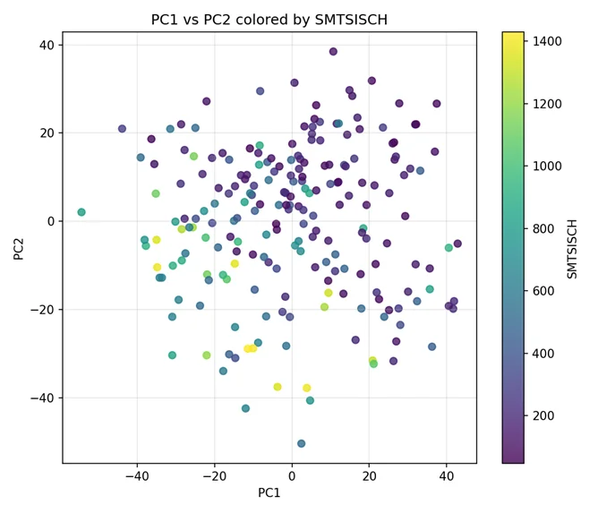
PC1 vs PC2 Colored by SMTSISCH (Ischemic Time)
Values are scattered throughout without clear clustering or smooth gradient. Ischemic time is not a dominant driver of the top two principal components. Any influence is likely weaker or captured in higher PCs.

Slide 40
Ischemic Time: Biological Interpretation
Ischemic time shows a mild directional effect in PCA space: samples with longer ischemic time tend to project to lower PC1/PC2 values.
Biologically: Prolonged ischemia induces RNA degradation and stress-related transcriptional changes in coronary artery tissue, subtly shifting global expression profiles.
However, the effect is gradual and does not form distinct clusters, indicating that ischemic time does not dominate overall gene-expression variance.

Slide 41
Conclusion
PC1 explains 15% of variance, PC2 explains 10.36%
PC1-PC5 explain ~39.85% of total variance
PC1-PC2 scatter shows no strong clustering among coronary artery samples
Coloring by SMRIN, SMTSISCH, SMNABTCH, SMGEBTCH shows no clear separation
Gene expression variation in Artery-Coronary tissue is distributed across multiple factors, not driven by a single technical confounder

Slide 42
Outlier Detection & Removal
Data Quality Control
Tissue: Artery - Coronary

Slide 43
Goal of Lab 6
Identify and remove outlier samples from the Artery-Coronary gene expression dataset to improve data quality
Ensure downstream analyses (PCA, clustering, regression) are not driven by extreme or low-quality samples
Dataset: Initial 213 samples, 17,309 genes with metadata including RNA quality, ischemic time, and batch variables

Slide 44
Why Outlier Detection Is Important
Outliers May Arise From:
Technical artifacts (RNA degradation, sequencing depth, batch effects)
Post-mortem effects
Rare or abnormal biological conditions
Keeping Strong Outliers Can:
Distort PCA structure | Inflate variance | Bias correlation and regression analyses

Slide 45
Outlier Detection Strategy
To robustly detect outliers, we used two independent methods:
1. PCA-based outlier detection
2. Hierarchical clustering of samples
Final decision based on union of samples flagged by any method (conservative approach)

Slide 46
Method 1: PCA-Based Outlier Detection
Approach
Standardized expression matrix (samples × genes)
Performed PCA and examined PC1 and PC2 coordinates
Computed z-scores across samples
Outlier Definition
Sample flagged if |z| > 3 on PC1 or PC2

Slide 47
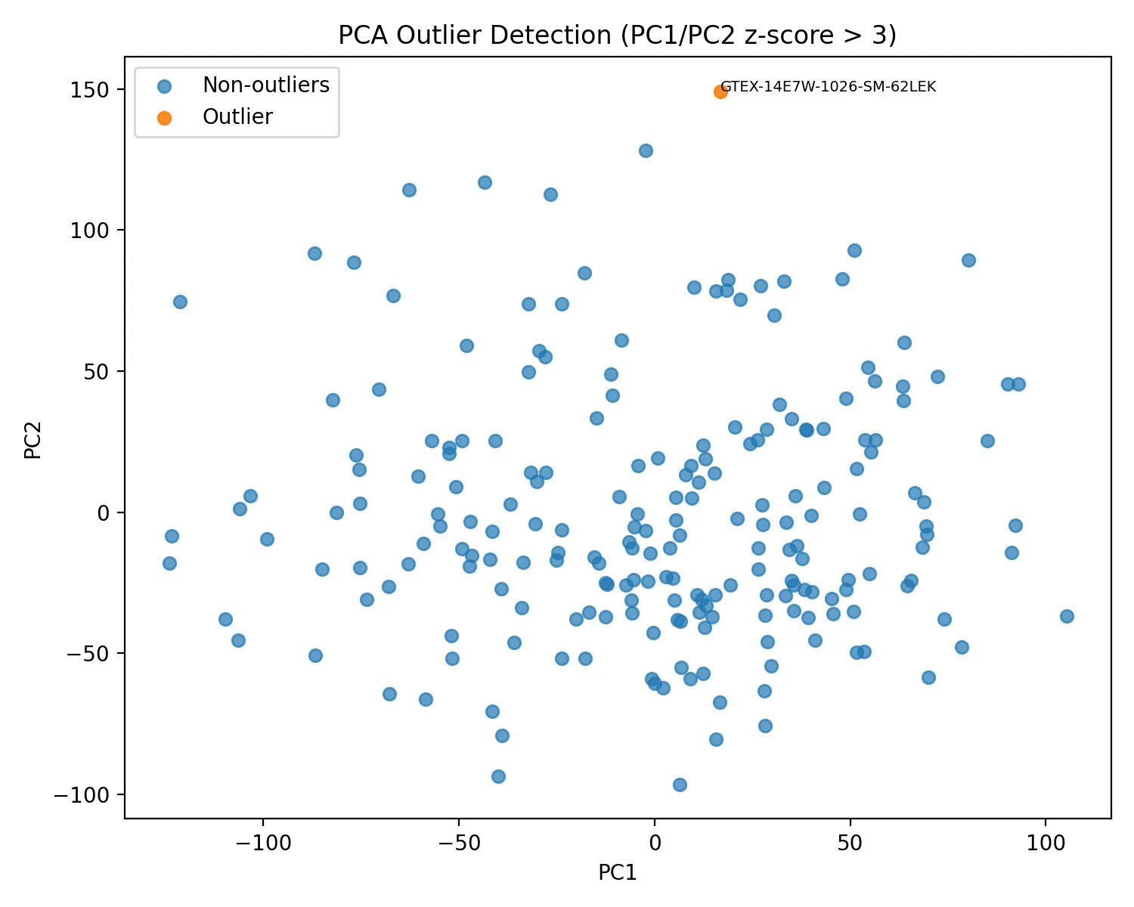
PCA Outlier Results
One sample lies far outside the main PCA cloud: GTEX-14E7W-1026-SM-62LEK
Shows extreme global expression patterns, likely reflecting technical or biological abnormality. Correctly identified as PCA outlier.

Slide 48
Method 2: Hierarchical Clustering
Computed correlation distance between samples
Applied average linkage hierarchical clustering
Generated full dendrogram (all samples) and truncated dendrogram (last merges only)
Truncated view highlights samples merging at highest distances for easier outlier identification

Slide 49
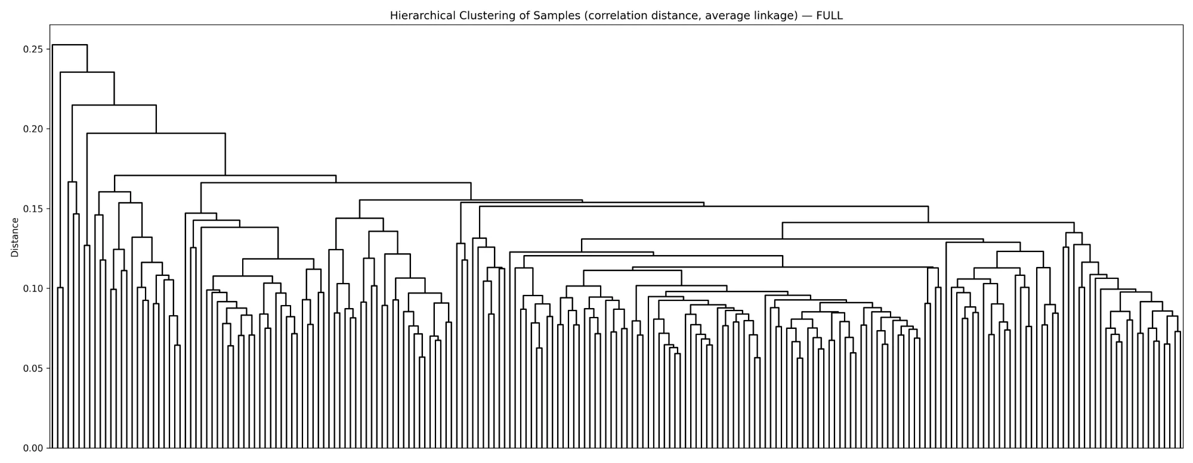
Full Dendrogram (All Samples)
Includes all 213 samples showing complete hierarchical structure. Difficult to interpret due to dataset size - individual samples cannot be clearly distinguished.

Slide 50
Full vs. Truncated Dendrogram
Full dendrogram: Shows all samples but difficult to interpret outliers
Truncated dendrogram: Shows only the last merges (highest distances)
Truncated view highlights samples merging at extreme distances, making outlier identification much clearer

Slide 51
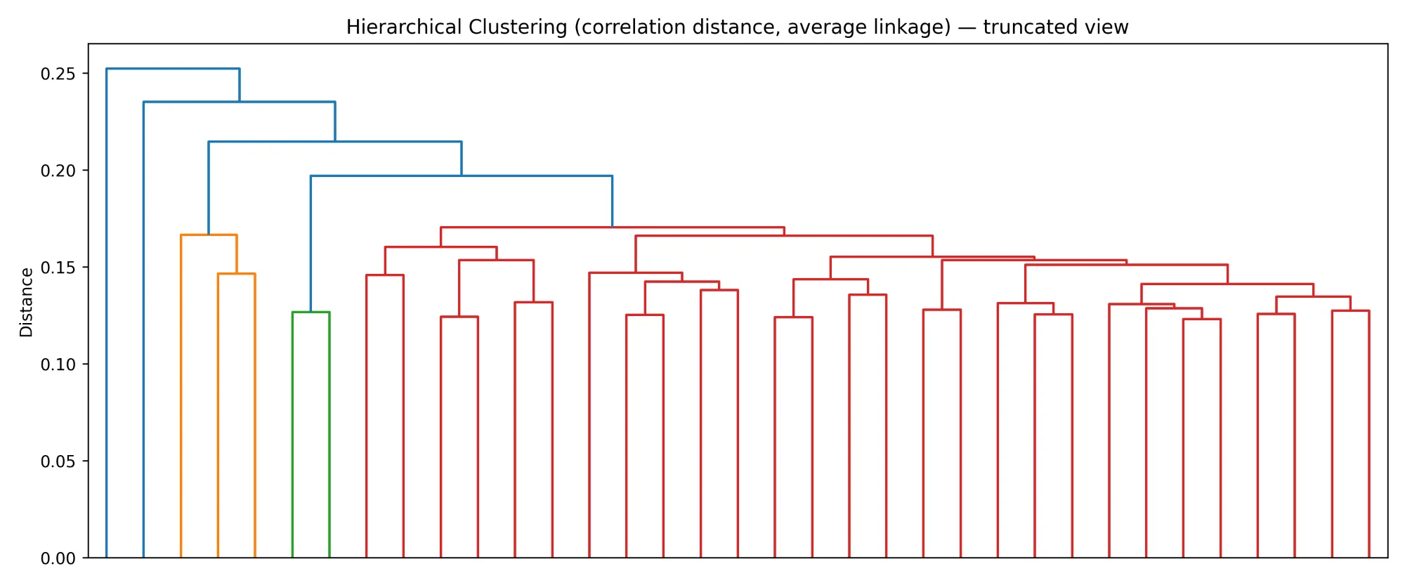
Hierarchical Clustering Outliers
Samples merging at extremely high distance (99th percentile). Small clusters (≤2 samples) at extreme cut are outliers.
GTEX-1EX96-2826-SM-7PBZQ | GTEX-1JMQJ-2526-SM-CY8HP | GTEX-WHSE-0726-SM-4RTXA
These correspond to far-left/last-merging branches in the dendrogram.

Slide 52
Combining Outlier Methods
PCA outliers: 1
Hierarchical clustering outliers: 3
Final removed samples: 4 (union of all methods)
Conservative strategy ensures no strong outlier influences downstream analyses

Slide 53
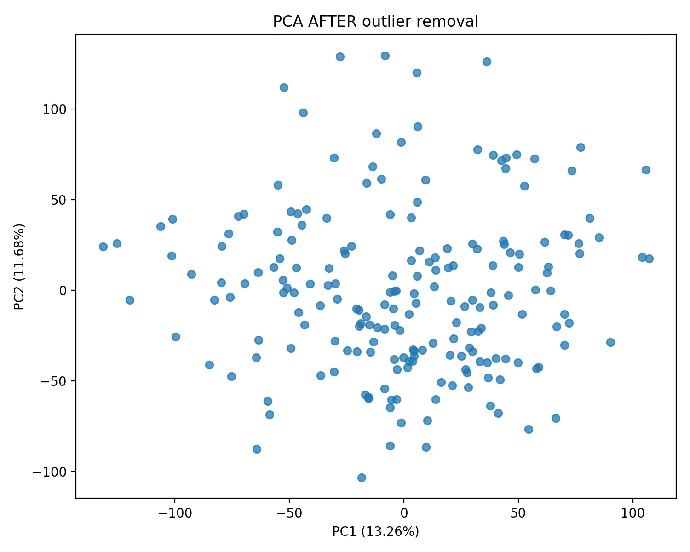
PCA After Outlier Removal
After removing identified outliers, PCA was recomputed. More compact sample cloud with no extreme points dominating PC1 or PC2. Improved data quality for downstream analysis.

Slide 54
Conclusions
Outliers detected using two complementary methods, each capturing different abnormality types
Union-based removal strategy is conservative and robust
Removing 4 samples improves stability of PCA and clustering
The cleaned dataset is now suitable for further biological analysis

Slide 55
Goal of Lab 7
After filtering, removing outliers, and normalizing the data, we must correct for confounders that influenced gene expression levels
Use multiple linear regression to neutralize noise and biases in the data
Residuals from regression become the corrected expression values for downstream analyses

Slide 56
Data Processing Pipeline
1. Gene Filtering: Remove low expression and low variance genes
2. Outlier Removal: Remove 4 outlier samples (from Lab 6)
3. Quantile Normalization: Equalize expression distributions
4. Standardization: Z-score transformation (mean=0, std=1)
5. Confounder Correction: Multiple linear regression

Slide 57
Identified Confounders
Technical Confounders:
SMRIN - RNA Integrity Number (quality)
SMNABTCH - Nucleic acid batch
SMGEBTCH - Expression/genotyping batch
Biological Confounders:
SMTSISCH - Ischemic time (post-mortem delay)
DTHHRDY - Death Type (Hardy scale - mode of death and agonal state)

Slide 58
Why Death Type Is a Biological Confounder
Death Type (DTHHRDY - Hardy scale) reflects mode of death and agonal state
Biological impact: Different death circumstances influence RNA quality and stress-related gene expression patterns
In coronary artery tissue, agonal state can trigger hypoxia-related transcriptional responses, making it a relevant biological confounder to control

Slide 59
Multiple Linear Regression Method
For each gene: Expression = β₀ + β₁(RIN) + β₂(Ischemic) + β₃(DeathType₁) + β₄(Batch₁) + ... + ε
Categorical variable (DeathType) is one-hot encoded. Batch variables were not included as categorical predictors.
Residuals (ε) = observed expression - predicted expression from confounders
Residuals represent corrected expression values free from technical and biological biases

Slide 60
Why Residuals Are Critical
Residuals = Observed Expression - Predicted Expression
Predicted expression captures only technical variation from confounders (RIN, ischemic time, batch)
Residuals contain only biological variation - the true signal we want to study
All downstream analyses use the residual matrix, not the original expression values

Slide 61
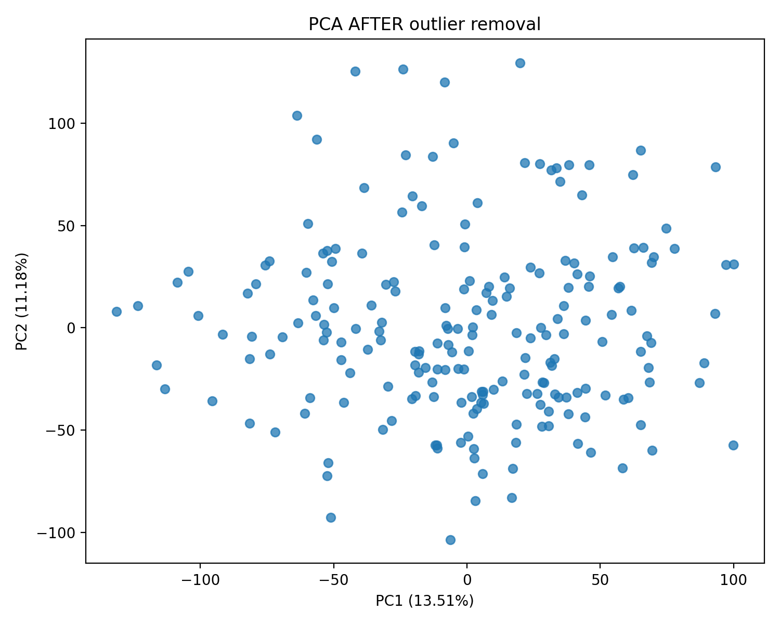
PCA After Correction

Slide 62
Before vs After Correction
Before Correction:
Visible patterns for RIN, ischemic time, death type, and batch effects in PCA
After Correction:
All confounders removed - uniform color distribution in PCA
Variance explained by PC1 increased: 25.5% → 29.4%
Data now represents biological variation of interest, not technical or death-related artifacts

Slide 63

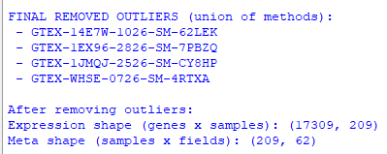
Data Transformation Results

Slide 64
Conclusion
Multiple linear regression successfully removed both technical and biological confounders from gene expression data
Technical confounders: RNA quality (RIN), batch effects (SMNABTCH, SMGEBTCH)
Biological confounders: Ischemic time, death type (Hardy scale)
Residual matrix represents cleaned biological signal free from technical and biological artifacts
Data is now ready for biological interpretation and downstream analyses with improved interpretability

